Slide 1




Needfinding report
challenges & opportunities in international college applications

Slide 2


WE WILL COVER...
01
Introducing the team & our topic
02
Needfinding methodology
03
Interview results & analysis
04
Summary
05
Next steps

Slide 3
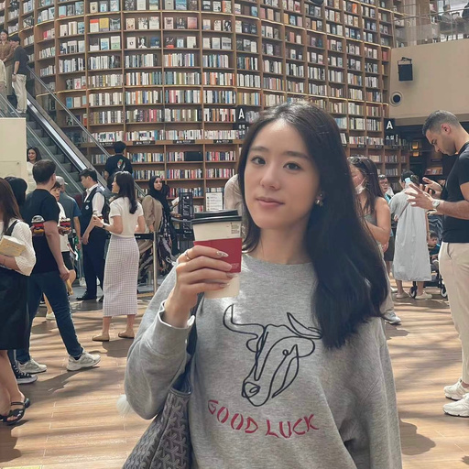
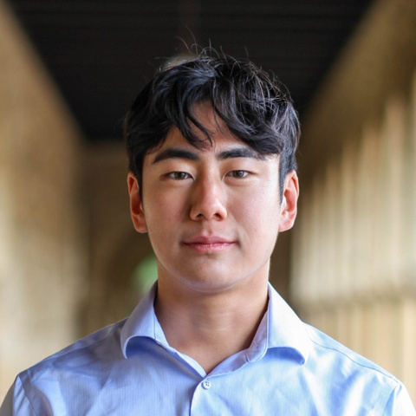
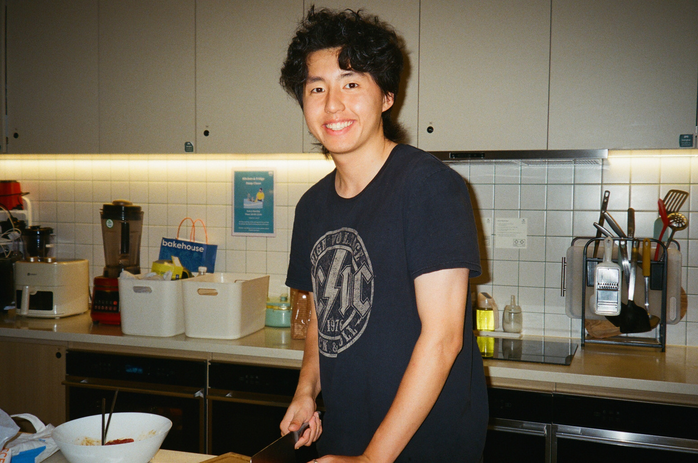
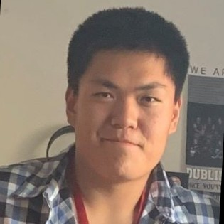
Meet the team!
Sally
Steve
ZIjian
ERIC
Economics ‘25
Hong Kong
CS ‘25
California
Symsys ‘26
Chengdu, China
CS ‘24
California

Slide 4


why this topic
Why education development and the focus on international students?
Personal Experience & Awareness
Relevance & Reach
Interest

Slide 5

needfinding methdology
Selecting Participants
1 parent, 1 college counselor, 1 international student & 1 American student
Choosing Questions
Some standardized and some specific to the stakeholder’s interests and concerns
Recognizing Limitations
International students chosen were in positions of privilege - but this is not representative

Slide 6

Example q’s
What has your experience been like with the college preparation/application process?
01
What is the biggest challenge in your role during this process and why?
02
What do you really like about the current education system?
03
How often do you interact with other stakeholders e.g. counselors and how were the interactions?
04
What resources did you find most useful in your college preparation process?
05

Slide 7

chinese parent
Background
CEO of engineering consulting firm in Shenzhen, China
Younger daughter in Hong Kong international school (grade 10)
Currently in the process of choosing a college consultant and facing difficulties
Hong Kong/China
Parent of grade 10 girl
Actively seeks out college consulting firms
Interview Format: Zoom
Key Quotes
“There are very few good things for the child out of this [college application] experience”
“The services offered by consulting firms right now are all in a pipeline—there is no individualization”

Slide 8
Parents choose to sign with a college consultant for different reasons
Some parents choose counselors to communicate better with their children
Some parents want the counselors to help students every step of the way
Students faced less stress before Covid
The fear of missing out - if you don’t sign with an agency, other people will
Chinese parent
Overwhelmed by the number of agencies to choose from (who all promise to be the best)
SAY
THINK
Students sign with counselors as early as Grade 9/10
Hard for children to show/develop their true passions
Agressive marketing by conusellors often hide the truth behind simple statistics
counselors come in all different forms
“John Locke [competition] is dominated by Chinese students”
Overwhelmed in the face of many consulting firms
Since Covid, the industry has become more complicated and difficult to navigate
If you want the best for your child, you work with the CEO - doubling or tripling the fee
Signing with the agency is only the first step in a never-ending purchasing cycle
Baseline price is 43k USD and could go up to 170k USD
College admissions cannot distinguish self-motivated students from their “packaged” peers
Overwhelmed in the face of many consulting firms
Students faced less stress before Covid
Hard for children to show/develop their true passions
Since Covid, the industry has become more complicated and difficult to navigate
Seeking out counselors is almost a must these days for international students
Many parents are very involved in the college application process
DO
FEEL
Many agencies are just “middleman” to overseas services
Frustrated at how “packaged” international students are
The college application process gives both students and parents a lot of stress
Parents have to filter out noise to find truly helpful resources - but it’s unclear whether they even exist
The college application process is filled with external factors
this does haha
Many students follow the same pipeline, so they do the same activities
Parents have to filter out noise to find truly helpful resources - but it’s unclear whether they even exist
A good counselor should grow and motivate the child, not or predetermine their paths
Parents feel pressured to help their children as much as possible
The college application process is filled with external factors
Because one family/person cannot change the system, you can only join in and “play the game”
Because one family/person cannot change the system, you can only join in and “play the game”
There are always more services you can purchase
Students/parents have to compete for the best services at one agency - even more payments?
Parents need to pay total deposit up front (no refunds)
Very difficult to counselors to be genuine in the current environment
Parents need to pay total deposit up front (no refunds)
The college admissions process can be just as stressful on the parents
A good counselor should grow and motivate the child, not or predetermine their paths
Standardized testing is being “gamed” in East Asia - which defeats their purpose

Slide 9
needs & insights
They need...
It would be great if...
A more transparent, genuine, and equal system to support international students in their college application journey
There is some way for international students to reduce reliance on “middleman” counselors that lack standardization and personalization

Slide 10
college Counselor
Background
College counselor with 8 years of experience
He mostly helped students in Asia, he works in Vietnam, Mainland China, and now in Hong Kong
He worked in international schools and private college application consulting companies
Hong Kong/China
Working with over 40 students this year
8 years of experience
Interview Format: Zoom
Key Quotes
“When you have to make sure the students go to schools with high rankings, that mentorship part goes away.”
“There are so many things that could be done to help us organize data.”

Slide 11
A lot of Asian students are not going to the program that’s the best fit for them
Asian parents prioritizes school rankings more than if the student match the school
College counseling is a very detail oriented job, work depends on students’ case
I like to build a close relationship with students and know them better
We need a way to better communicate with parents and convince them to something not traditional but benefit the students
Mentoring the students is important
hk counselor
SAY
THINK
Counselors’ salary and bonuses are linked to if students get into top schools, and it’s about money for the companies and schools
Had many students who went to schools they didn’t like but with higher rankings and feel bad about that
The interest of private companies and schools are sometimes mis aligned with students’ interest
When it comes to organizing data of students, the most important thing is to keep it simple
It’s difficult to communicate with the parents sometimes
Wish I could be more like a mentor to the students but it’s hard
Asian parents’ stances are very traditional
Some students need mentorship to find better matching schools and transition to life in a foreign conntry
I spend a lot of time organizing student data, I wish there could be a tool that helps with that
College applications change every year, as a counselor, you need to keep up with the new policies and school-related info
There needs to be a more organized system for summer program applications.
Asian parents are hard to work with. Vietnam parents and mainland China parents especially care about school rankings
Tried using some apps to organize data but they are hard to use
A lot could be done to make data organization better.
Summer programs need a better application system
Try to find the best match for students, introduce liberal arts colleges
Use excel sheets to keep track of student activity list and sometimes make mistakes
DO
FEEL
Frustrated about the situation with international schools and private companies that they prioritize profit
this does haha
Tried to mentor the students but that usually goes away when it gets closer to the application deadlines
It’s sad that some students are forced into some schools against their will
Happy to see some students do well
Want to focus on mentoring and guiding students more
Keep track of multiple students application status and progress at the same time.
Check essays for each school every year to make sure information is up to date
Create shared drive with students to keep track of information/updates
It would be helpful to have some tool to better keep track of student information
Frustrated that Asian parents value the rankings of school too much
Tried to convince Asian parents to send their kids to school with better diversity but usually fails.
Make mistakes because spreadsheet cell changes are hard to notice
Work on spreadsheet is tedious, could be frustrating sometimes
Used apps like cialfo, but now still using spreadsheet
Don’t have a good solution to communicating with certain parents
Parents need to pay total deposit up front (no refunds)
The work is repetitive but still have to update the information even when the changes are minor
A good counselor should grow and motivate the child, not or predetermine their paths

Slide 12
needs & insights
They need...
It would be great if...
A way to work with students in less profit-driven settings and a better way to manage student data
Connect parents with someone who can convince them better and build a tool for counselors that updates information and keep data

Slide 13
Stanford Student
Background
London student in French Schooling
Brothers both went to Stanford
Applied and accepted to Stanford ED
From London French Schools
Senior
Interview Format: In-Person
Key Quotes
“Our French schooling system never taught us how to apply or gave me any resources ”
“The majority of my application support came from my brothers and parents who had already gone through the process ”

Slide 14
SATs were completely foreign to him until the process started
I had to be very selective with letters of recommendation.
My friends didn’t look at International Schools because they tend to be very expensive
Process forced him to lean into his own skills & learn how to highlight them
The way college apps are set up cannot really get to know someone well
stanford student
Schools with high ranking are more valuable
SAY
THINK
The only resources I had were my parents & brothers
“Unlike Americans” perception of applications in America being guided
Thinks friends wouldn’t consider the process for international schooling due to cost
Writing about yourself in French is typically different than English
I wasn’t sure what I was going to do apply to college, I just knew I going STEM”
My brothers told me to apply since they knew I had a better chance with two brothers @ stanford
His process didn’t really change from his brothers.
American education isn’t perfect
Studying at a country in second language was intimidating
Unliike Americans, I didn’t have college counselor
American ideals/benchmark seem more “fake” while French are more objective
School name was more important that program/degree
It wasn’t as difficult as most students since he has two brothers @ stanford
It was lucky for me that I had 2 brothers who have done this already
Changes should be made to how applications are conducted
Commonly would seek brothers for advice
Communicate with brothers and parents about the application a lot
DO
FEEL
Made his decision on school based on brother’s insistence
Felt as if any resources school could provide would be inadequate
Understood that international schooling is expensive and unobtainable for peers
this does haha
Tried to step in the shoes of an American applicant
Other international students might not have the immediate resource he did
Feels that Americans culturally are very different
A lot of self-guiding and exploration
Frustrated in the “fakeness” of school applications
Insecure about vouching for himself or his achievements
Sought help and LOR from those accustom to the American process
Didn’t talk to friends about applications
Do tasks in ways that he felt Americans would be most receptive to
Isolated and cannot relate to a lot of friends around him
Applying to US universities comes with a lot more barriers for international students
Did not resort to a lot of outside help
His process didn’t really change from his brothers.
He really leaned in on his brothers’ support - he was lucky in that sense
Did research on US-schools by himself.

Slide 15
needs & insights
They need...
It would be great if...
Applying Students could find guidance on applications while accounting for cultural gaps and norms
To be perceived genuinely and to culturally assimilate

Slide 16

Domestic Student
Background
Finished two-years of community college before transferring to UCSB
Majoring in Accounting/Business
Grew up in the Bay Area in a competitive high school environment
UC Santa Barbara
Senior
From Cupertino
Interview Format: In-person
Key Quotes
“I learned the most about applying to college from speaking with other students. My counselors didn’t help at all.”
“I couldn’t afford a private counselor, and since English wasn’t my native language, it was hard to speak with counselors.”

Slide 17
He used multiple websites to find out strategies to apply to colleges
He used simple tools like the G-Suite to organize his college applications
People are putting too much pressure on each other in high school
The high school system is not well-equipped to support its number of students
DOMESTIC student
There was a student who tried to sabotage others at their high school
There’s a lot of competition to do extracurricular activities
SAY
THINK
College counselors don’t actually know what they’re doing
He wasted a lot of time on activities that he didn’t enjoy just for college appluications
He said he had a lot of fun doing summer programs
A lot of information online is outdated from year to year
The students who grew up in competitive middle schools had an advantage
There are many resources online
There are many resources online
There should be tools to aggregate the information found online
Students who don’t have a good English background are at a disadvantage
Counselors are overwhelmed
High school counselors could only meet twice a year with each student
He was tempted multiple times to hire a private counselor
The counselors gave generic advice, and didn’t really help when he asked them for personal advice
Too many students are applying to too few schools
Sought out online, easy-to-access resources
Turned to other people to learn how to apply to colleges
DO
FEEL
Did a lot of extracurricular activities in college because he saw others doing them
Annoyed at how expense college application help is so expensive
Confused about how to write essays
Confused about how to write his activities on his application
this does haha
Spent 3 hours a day for 2 weeks working on applications
Extremely pressured when they see other people applying to colleges
Crammed a lot of applications the days before they were due
Tried (unsuccessfully) multiple times to meet with his school counselor
Felt incredibly burnt out after applying to just a few colleges
Didn’t approach his teachers since it seemed like they were overwhelmed
That paid counselors and school counselors are not very knowledgable
Looked at other successful applicants’ essays
Fearful of approaching counselors or other experts in the space
Skeptical of how well certain resources work
Paid students small amounts of money to edit his essays
Exaggerated certain parts of his essays because he saw other people doing the same
Disappointed at the results of his applications
Stressed about the overwhelming amount of information online

Slide 18
needs & insights
They need...
It would be great if...
A way to receive a personalized, tried-and-tested way of learning how to apply to colleges
Receive advice from students who have researched and been through the college application process

Slide 19
sUMMARY
Applying to colleges in the US for international students can often come with many barriers - financial, information gap, etc.
01
Some choose to not apply at all due to problems of cost, while others with the resources face their own struggles
02
The college consulting industry is oversaturated in East Asia - and the quality of firms is questionable
03
Even for domestic students, the quality of counsellors is unreliable - not PERSONALIZED!
04
The tools counsellors use to manage data/relationships can be improved
05

Slide 20

whats’ next?
Expand our interviewee scope to capture a broader range of users and stakeholders
Narrow down on particular painpoints we want to address
HMW statements and experience prototyping

Slide 21
Thank you for listening

Slide 22
People were interested in applying to schools in Florida because it was close and had a Latinx community
Her brother did much worse because he didn’t have anyone to help him, unlike her
There should be more students sharing their experience online, through platforms like blogs
The high school system is not well-equipped to support its number of students
Bolivian student
The process is flawed since it selects for more domestic students
It’s better to learn from other students who have been through the process
SAY
THINK
She didn’t really care about grades until she noticed other people did
She wants a better way to track college information because she didn’t know what quarter system was like
She wasted a lot of time on activities that he didn’t enjoy just for college applications
The college application process involves a lot of unknown factors
College counselor's involvement was minimal, contributing mainly to logistical tasks like transcripts
There are many resources online that can be consildated
Her profile was more of a persona than something genuine
There should be tools to aggregate the information found online
Didn’t get into NYU, but did get into more competitive schools which she said was because she asked for financial aid
Students who don’t have a good English background are at a disadvantage
There was a lot of parental pressure in her decision-making process.
Counselors are not helpful, especially in international settings
Students don’t really know how to pick schools to apply to, other than word of mouth
Lots of people were super competitive and wanted to get into good schools
Considered pre-med, and she got pressured into applying for CS
COVID gave her the time to focus on college essays
DO
FEEL
Took a lot of AP classes to help with her applications
Annoyed at how expense college application help is so expensive
She didn’t know what to write about in her college essay
Uncertain of if she should talk about her international background in her application
this does haha
Never paid for a service, but wishes she did
Competition was unfair because a lot of people had rich parents who would help with apps
Crammed a lot of applications the days before they were due
Doesn’t respond well to parent pressure, so often did the opposite of what they said
It’s more of a numbers game for international, since she believes colleges don’t want you to apply for fin aid
Tried her best to avoid peer pressure, since it only made her mental health worse off
Interested in cognitive psychology so she changed what she applied as
Started prepping since Junior year of high school
Nervous competing with domestic students
Unsure of how to craft her “persona” to fit what colleges were looking for
Went to a cram school in Korea to study for the SAT
Her cousin helped her out a lot because she had experience consulting other applicants
She didn’t apply to a lot of schools because she felt disadvantaged as an international student
Brother pressured her to be software engineer

